Slide 1

The Hardest way to present at a conference
Bsides kc 2019 Badge
Bsides kC 2019 Kids Badge

Slide 2
BADGE PIRATES
WE'RE A SMALL GROUP OF HACKERS & MAKERS
We build electronic badges for security conferences for fun and no profit. Each badge is painstakingly designed and built with unique surprises and attention to detail.

Slide 3
Who are we
Kevin - FG
Carl - Networkgeek
Patrick - JiggleBilly
Patrick – pecord
Steff - whthat

Slide 4
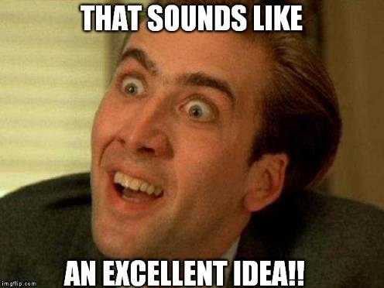
In the Beginning – Great Idea
Notes:
In the Beginning
Carl and I figured we could build a badge pretty easy
PCB
Easy to just simply add Electronics
DC25
Basic PCB with Dev Board
Hand Painted
Bsides 2018
Square Board
20 Charlie Plex LED
Ran off of AT Tiny 85

Slide 5
Schedule of Events – Bsides Badge
Sept 2018 – Initial Brain Storming – Picking out platform
Notes:
Last year we had just 2 months, We needed more time this year
September we started brainstorming
Picked Platform after several test
ESP 32- To Big, expensive – 3$
8266
Had Wifi
Had Many IO Pins
Can use Arduino IDE to program
Expand to Micro Python if we got too cocky

Slide 6
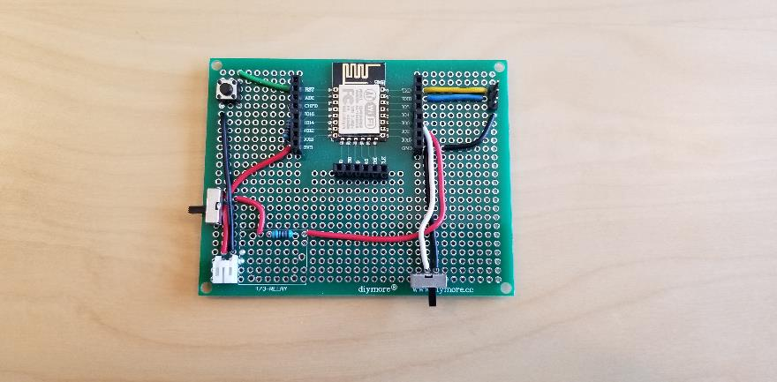
Breadboard of Platform Prototype
Notes:
First we wanted to make a repeatable platform
Layout out a MCU (8266) on an open breadboard
This to get the wire layout

Slide 7
Schedule of Events – Bsides Badge
Sept 2018 – Initial Brain Storming – Picking out platform
Nov 2018 – Design brain storming – What cant we do
First Platform Prototype – WROOM 8266-02
Notes:
After Breadboarding we ordered or first prototype
WROOM 8266-02

Slide 8
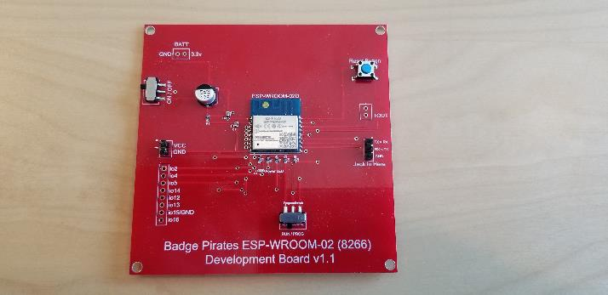
Platform Prototypes (Dev Boards)
Notes:
Yes .. Version 1.1 .. I messed up traces on v1, but hey its only 5$ (plus shipping)

Slide 9
Schedule of Events – Bsides Badge
Sept 2018 – Initial Brain Storming – Picking out platform
Nov 2018 – Design brain storming – What cant we do
First Platform Prototype – WROOM 8266-02
Dec 2018 – Second Platform Prototype – ESP 8266 12F
Third Platform Prototype
Notes:
Change of 8266 type
Tried what we had, Different version
Settled on 12F, least number of pins after program mode
This lead to v2.0

Slide 10
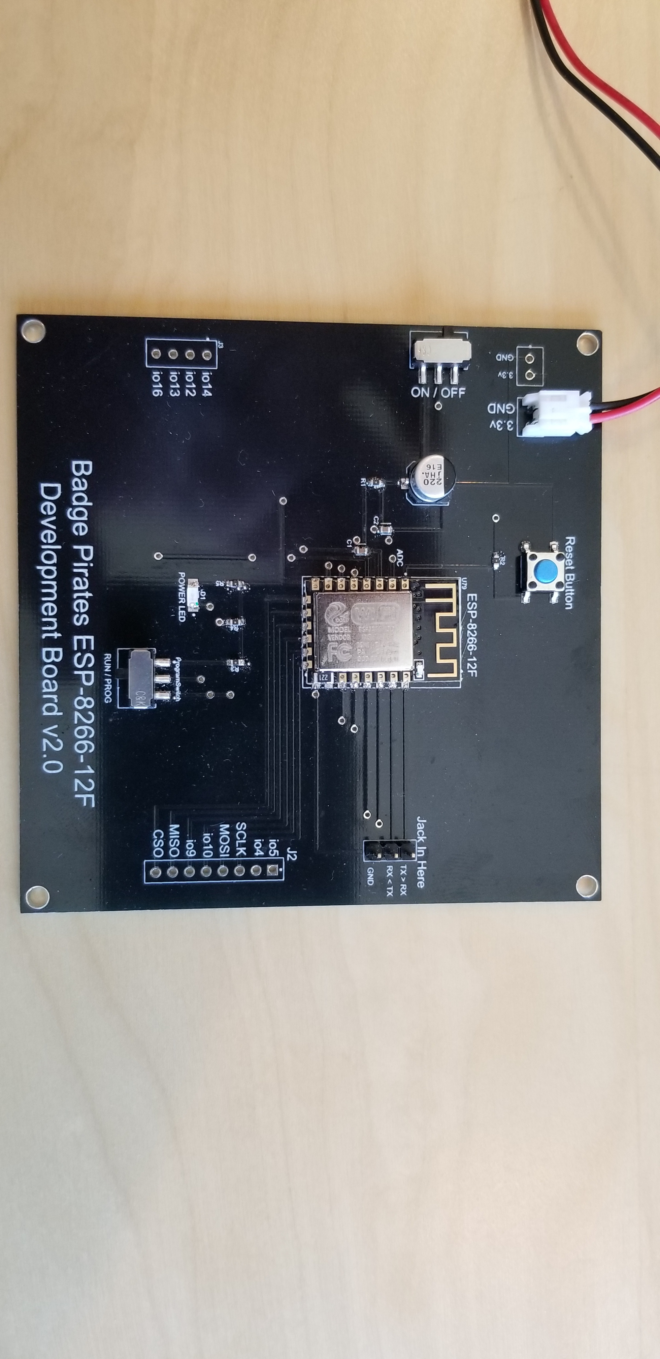
Change of Board to 12F
Notes:
Somewhat happy with this but already planning v2.1
Need to add resister, and add more pin out
Found that some of the pins we needed to bring to ground for programming can be re-used

Slide 11
Schedule of Events – Bsides Badge
Sept 2018 – Initial Brain Storming – Picking out platform
Nov 2018 – Design brain storming – What cant we do
First Platform Prototype – WROOM 8266-02
Dec 2018 – Second Platform Prototype – ESP 8266 12F
Third Platform Prototype
January 2019 – First Design Prototype (of several)
Notes:
Now we are getting going
Design prototype – Did they like how it looked?
Will it work?

Slide 12
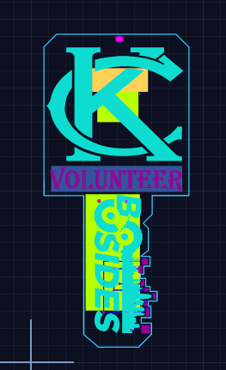
Design Prototype

Slide 13
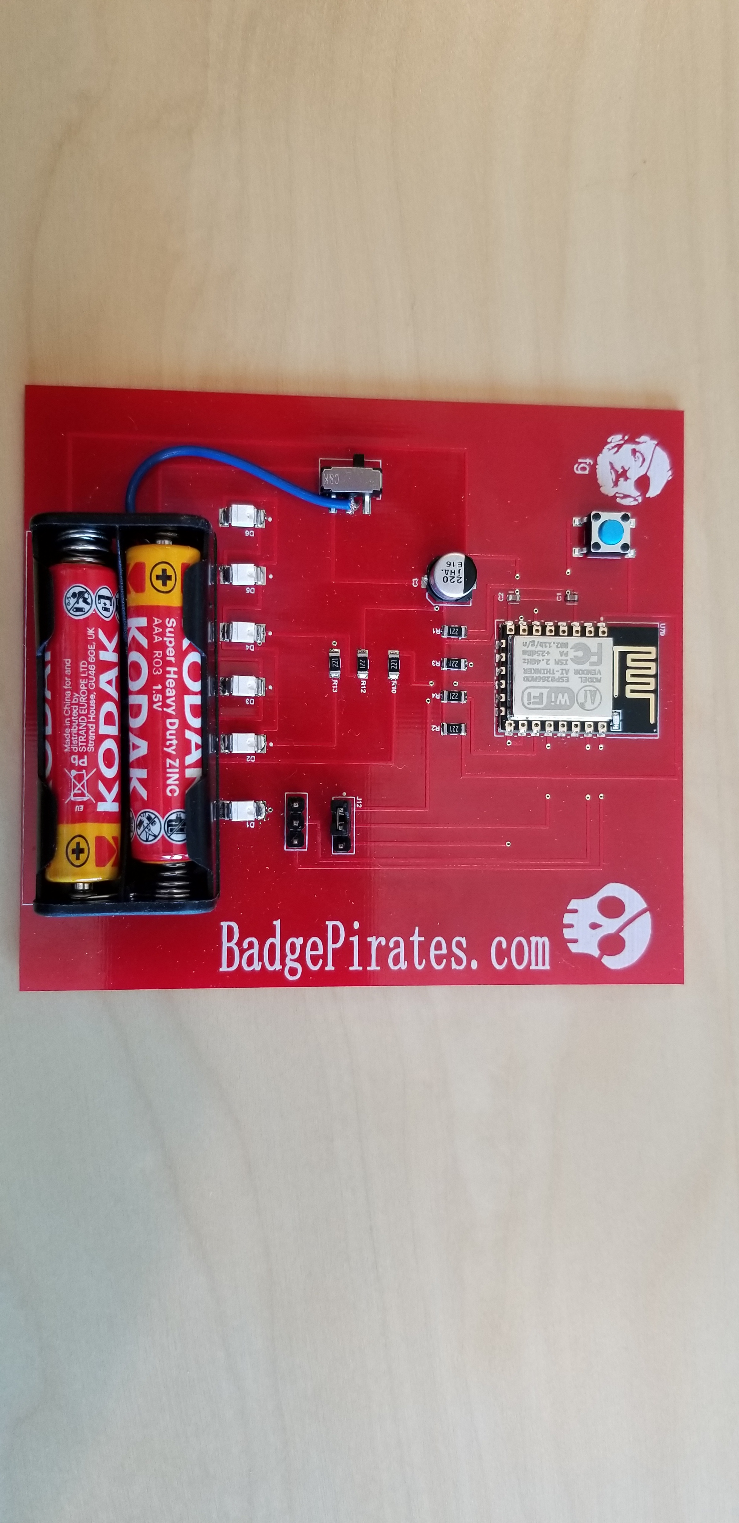
Function Prototype
Notes:
Lessoned learning
- Run a functional prototype THEN put on Design Prototype

Slide 14
Schedule of Events – Bsides Badge
Sept 2018 – Initial Brain Storming – Picking out platform
Nov 2018 – Design brain storming – What cant we do
First Platform Prototype – WROOM 8266-02
Dec 2018 – Second Platform Prototype – ESP 8266 12F
Third Platform Prototype
January 2019 – First Design Prototype (of several)
Feb 2019 – Final Design and Order of Produced Badges from China
Notes:
So prototypes were good
Everything worked and we had all the resisters in the right spot
Everyone is happy – LETS GO !!!

Slide 15
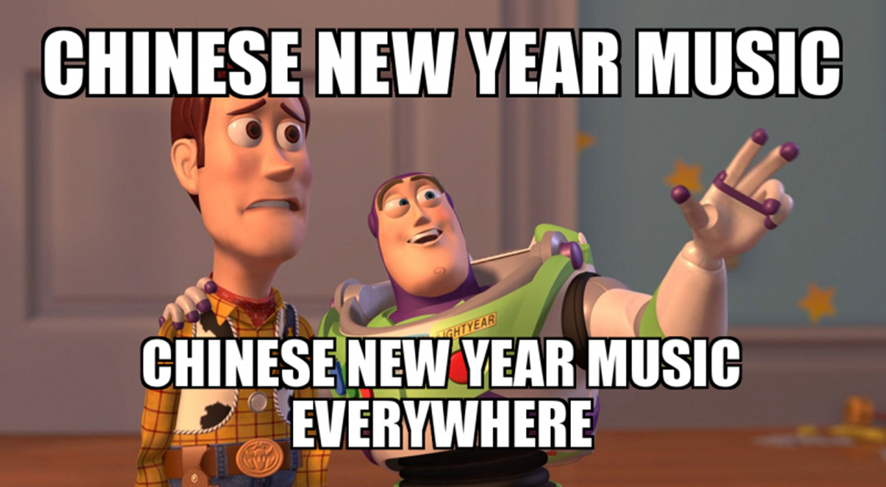
Problem with Feb China Production
Notes:
2+ weeks of everyone in China shutting down
No worries, we will wait, we should have plenty of time.. This year

Slide 16
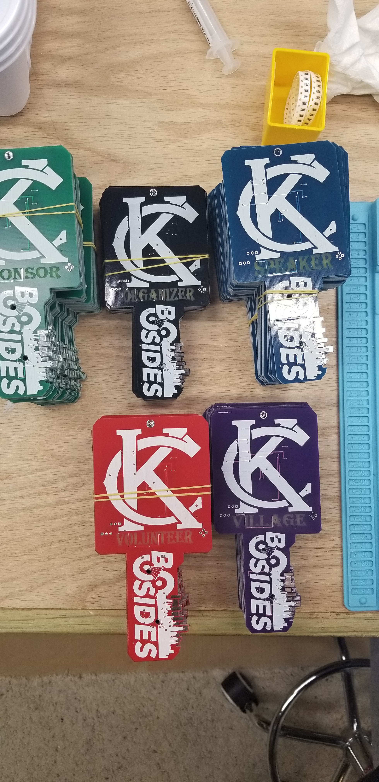
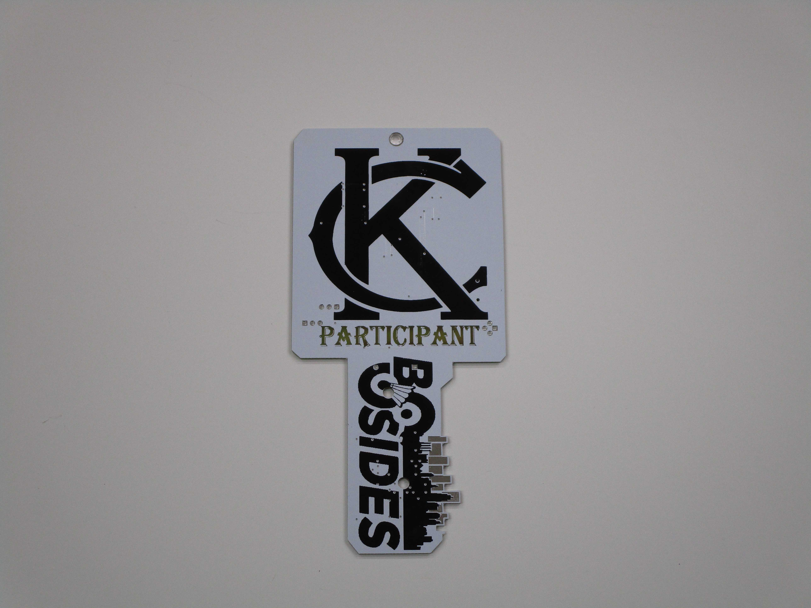
Finished Versions
Notes:
We got all the Badges !!!

Slide 17
Schedule of Events – Bsides Badge
Sept 2018 – Initial Brain Storming – Picking out platform
Nov 2018 – Design brain storming – What cant we do
First Platform Prototype – WROOM 8266-02
Dec 2018 – Second Platform Prototype – ESP 8266 12F
Third Platform Prototype
January 2019 – First Design Prototype (of several)
Feb 2019 – Final Design and Order of Produced Badges from China
April 2019 – Final Push for Code Development, Assembly and Program
Notes:
Boards are in
We are building Alternate Badges with Electronics
Lessoned Learned from last year – All comps on same side makes it easier
We are adding functionality
We are cleaning up Code
We are adding the game theory – wops
We are testing and QA each badge – Only 7 out of 350 Elect Bad
We are pushing final Code
We are READY!!!

Slide 18
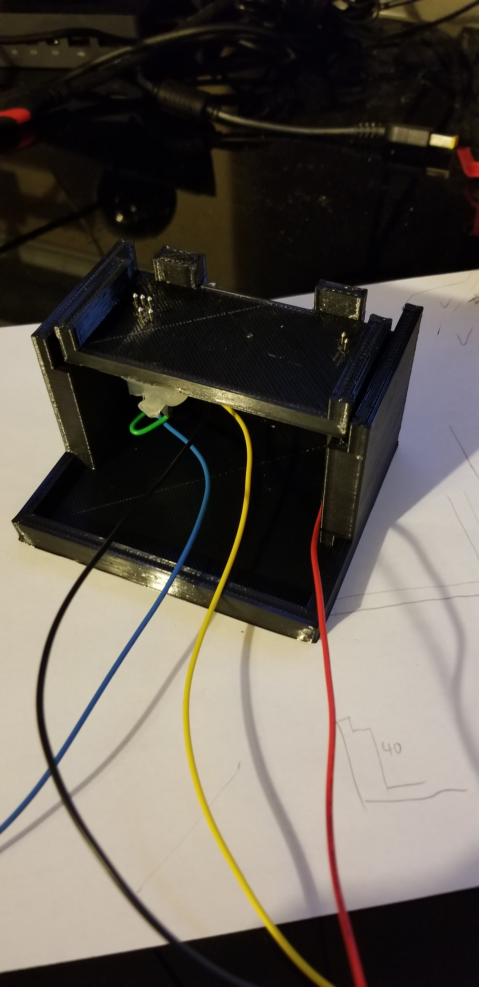
Programming Jig
Looks Good
Well Mostly works
Inconsistent

Slide 19
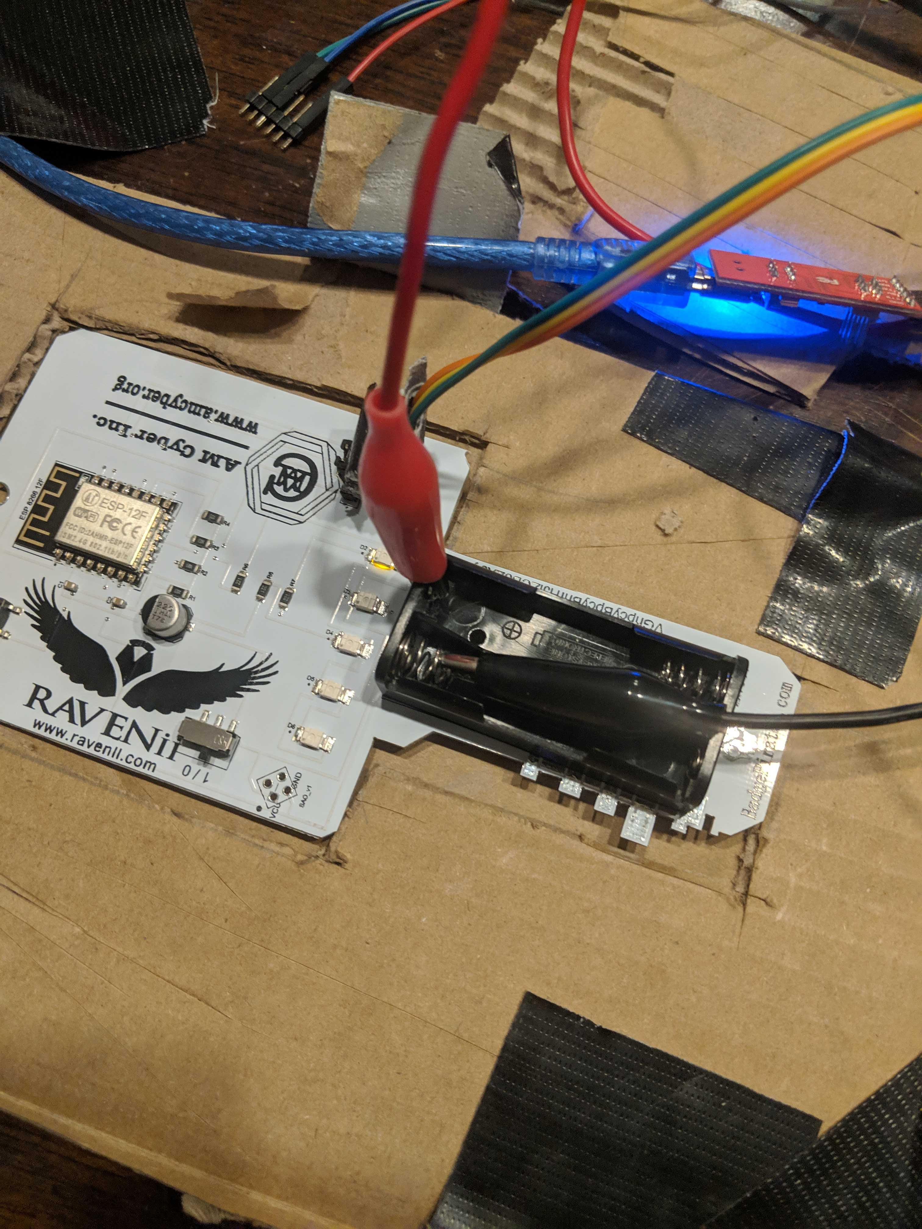
Programming Jig –v2
Yes that is Cardboard
Yes it worked

Slide 20
Schedule of Events – Bsides Badge
Sept 2018 – Initial Brain Storming – Picking out platform
Nov 2018 – Design brain storming – What cant we do
First Platform Prototype – WROOM 8266-02
Dec 2018 – Second Platform Prototype – ESP 8266 12F
Third Platform Prototype
January 2019 – First Design Prototype (of several)
Feb 2019 – Final Design and Order of Produced Badges from China
April 2019 to Yesterday Night – Final Push for Code Development, Assembly, Game
Now – Brain Storming of BSidesKC 2020 Badge !!!!!
Notes:
Since we are ready, lets start talking about NEXT YEAR .. Ugnnn

Slide 21

Next Year

Slide 22
What does the Badge Do?
It has wireless
And Uses the Wireless
Has Blinky Lights
Back Lit (reverse mount)
Different patterns
It has a game
If you haven’t figured it out yet
“Its just an Adventure”

Slide 23
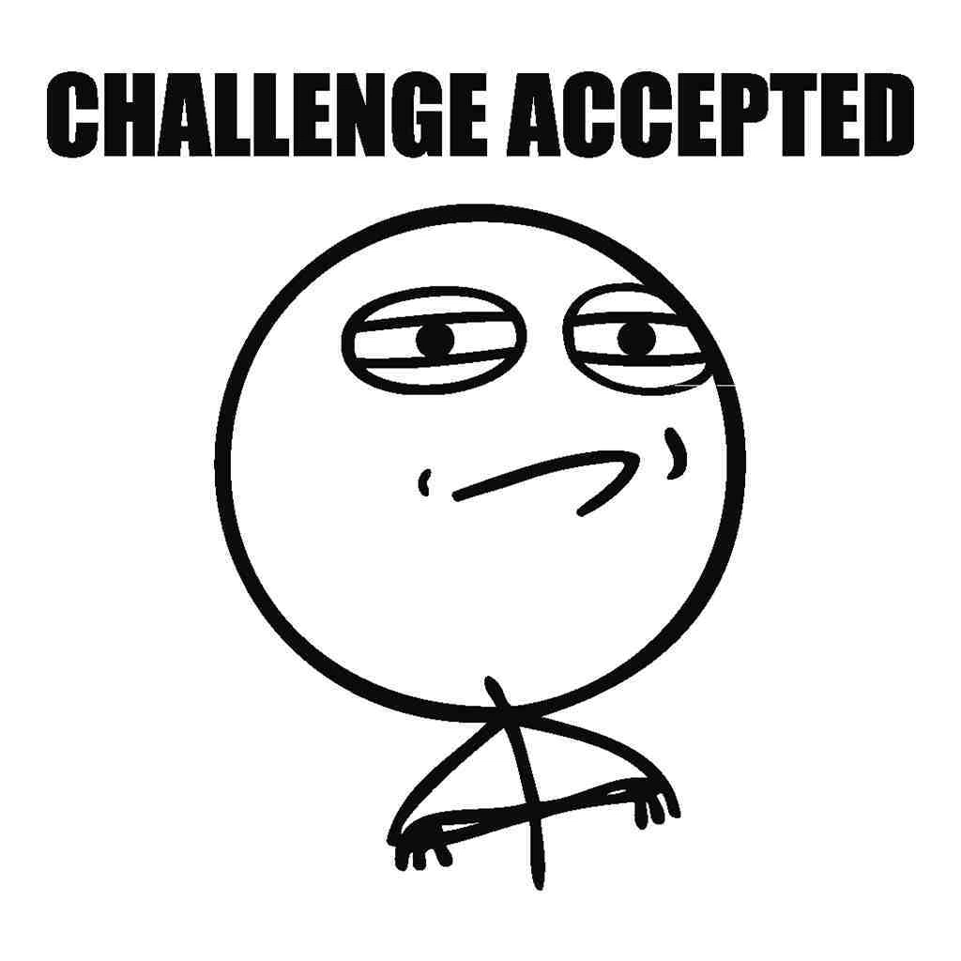
Is there hidden Things in Badge?
Notes:
Is there anything hidden in the badge?
Well I am not saying there is or there isn’t, but First person to solve it gets a “Pirate” Version of the badge
Everyone else gets a special Add-on

Slide 24
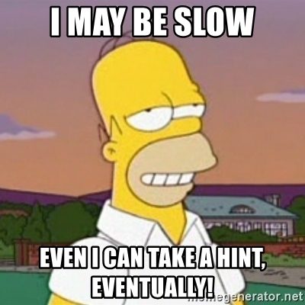
Gronsfeld
Notes:
Wait 10 seconds… just look around the room

Slide 25
Bsides kc 2019 Kids badge
Brain Storming
Something Interactive for the Kids
Something they can solder for a simple Learn to solder
Fun
More functionality

Slide 26
Brain storming
Ray Gun

Slide 27
Brain storming
Ray Gun
Raptor on Hoverboards

Slide 28
Brain storming
Ray Gun
Raptor on Hoverboards
T-Rex

Slide 29
Brain storming
Ray Gun
Raptor on Hoverboards
T-Rex
“What's in Fortnite we can use??”

Slide 30
Brain storming
Ray Gun
Raptor on Hoverboards
T-Rex
“What's in Fortnite we can use??”
……. Yeah we are old

Slide 31

Bsides kc 2019 Kids badge

Slide 32

Shark

Slide 33

Shark with laser

Slide 34
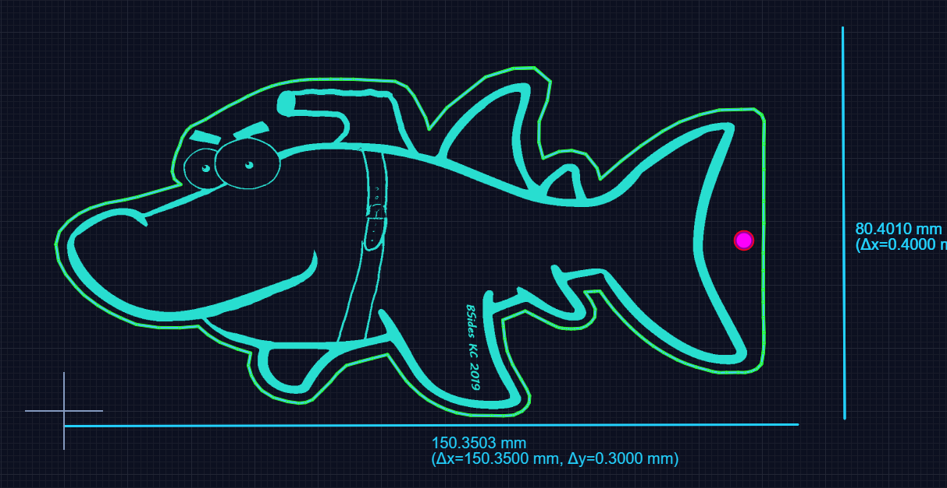

Slide 35
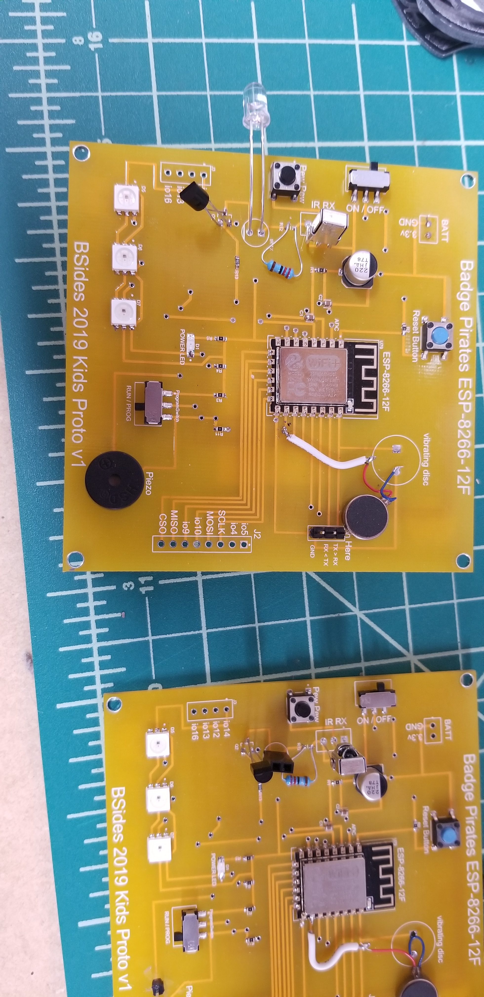
Development Board

Slide 36
Kids Badge - Features
IR Send / Receive
Power Indicator
Speaker
Vibrating Disk
3 NeoPixel LED
2 AAA Battery
ESP-8266-12F

Slide 37
Badge Testing
Functionality
Usability
Stress Testing

Slide 38
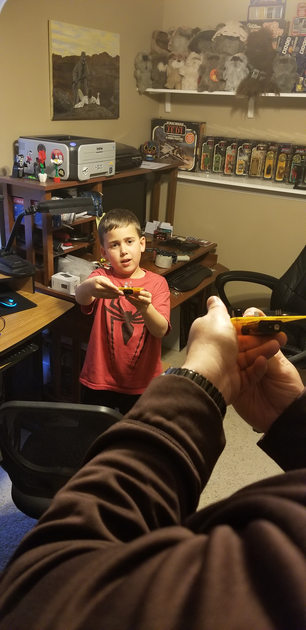
Badge Testing
Functionality - Kid approved
Usability
Stress Testing

Slide 39
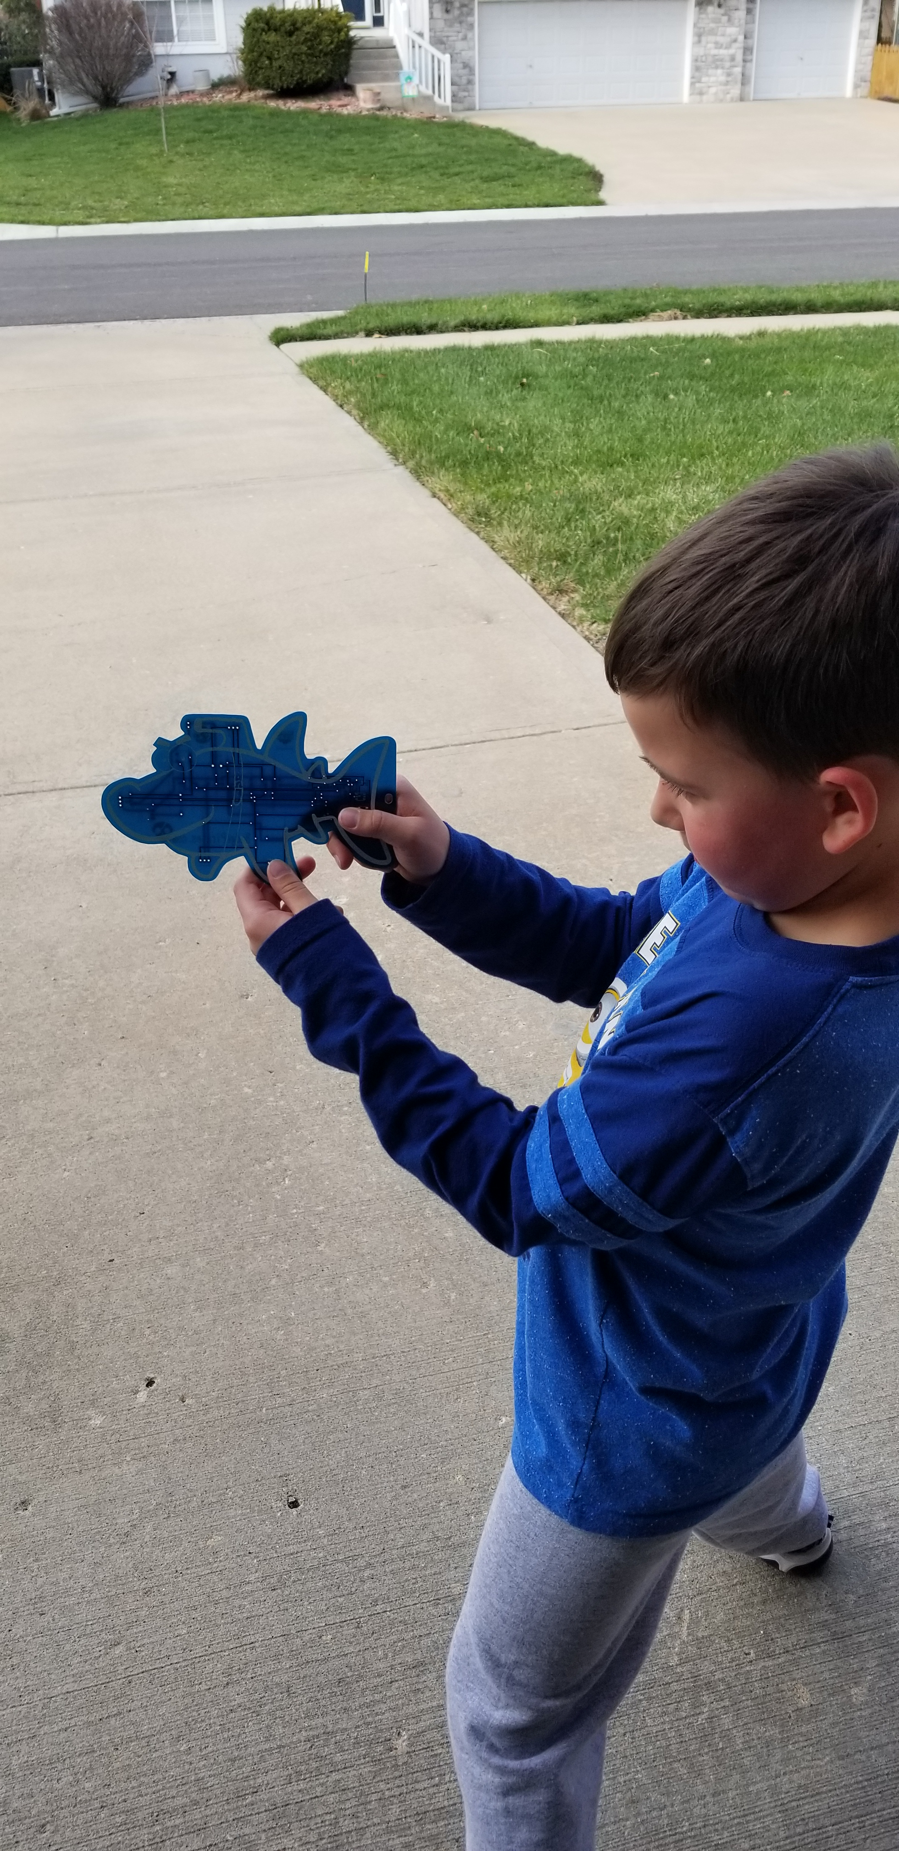
Badge Testing
Functionality - Kid approved
Usability – Kid Approved
Stress Testing

Slide 40
Badge Testing
Functionality - Kid approved
Usability – Kid Approved
Stress Testing – 30,000 Cycles shooting at each other

Slide 41
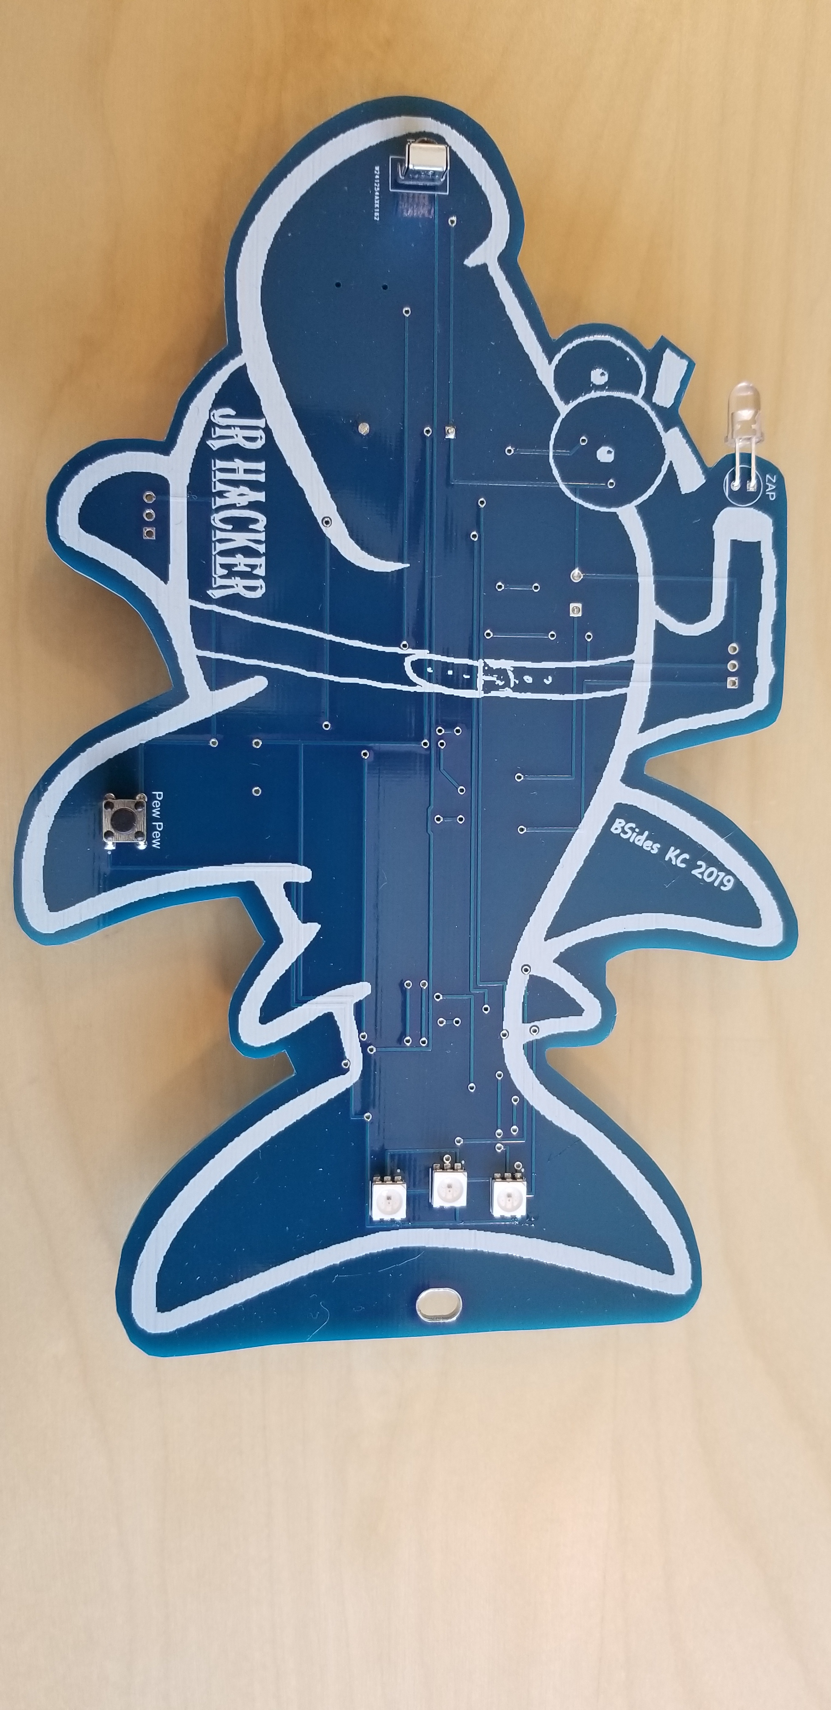
Bsides KC 2019 Kids Badge

Slide 42
Contact
Webpage: BadgePirates.com
Twitter: @BadgePiratesLLC
Email: admin@badgepirates.com
Other resources: cryptochallenges.com

